Slide 1
SMART FITNESS MANAGEMENT SYSTEM

Slide 2
Abstract
The Smart Fitness Management System enables easy tracking of daily routines with features like exercise logging and history viewing. It utilizes MongoDB, Express.js, React.js, and Node.js for efficient development and JWT authentication for secure access. A novel ML approach, employing a gradient boosting algorithm, predicts fitness levels accurately. However, integration and fine-tuning of the ML model may pose complexity and resource requirements. Overall, the system provides a user-friendly platform for effective fitness management.

Slide 3
Introduction
The Smart Fitness Management System enables users to track cardio and resistance exercises, monitor progress, and receive personalized insights through predictive analytics.
Our project combines the robust capabilities of the MERN stack with the predictive power of the gradient boosting machine learning algorithm to develop a smart fitness management system.
By leveraging the efficiency of MERN technologies and the accuracy of gradient boosting, we aim to empower individuals to effortlessly track and manage their fitness routines while providing predictive insights to optimize their well-being.

Slide 4
Existing System
Many fitness tracking websites utilize modern technologies to create dynamic platforms for users to monitor their activities efficiently.
Some platforms incorporate data analysis techniques to provide users with insights into their fitness progress and trends.
Despite advancements, concerns persist regarding the accuracy of fitness tracker measurements, impacting consumer confidence and reliability. Collection of sensitive health data raises significant privacy concerns and risks of data breaches or misuse.
Usability Issues: Some platforms suffer from usability issues, such as complicated interfaces or lack of user-friendly features, limiting user engagement and satisfaction.

Slide 5
Proposed System
The proposed MERN-stack application offers a more user-friendly interface compared to existing systems, ensuring ease of navigation and interaction for individuals tracking their fitness routines.
Leveraging advanced machine learning techniques such as the Gradient Boosting Classification algorithm, the system enhances accuracy in fitness tracking and prediction, addressing concerns regarding measurement precision and reliability.
Incorporating JWT Authentication technology ensures robust security measures, safeguarding users' sensitive health data and mitigating privacy risks inherent in existing systems.
The proposed system provides personalized insights and recommendations tailored to users' fitness levels and goals, enabling more effective decision-making and goal-setting.

Slide 6
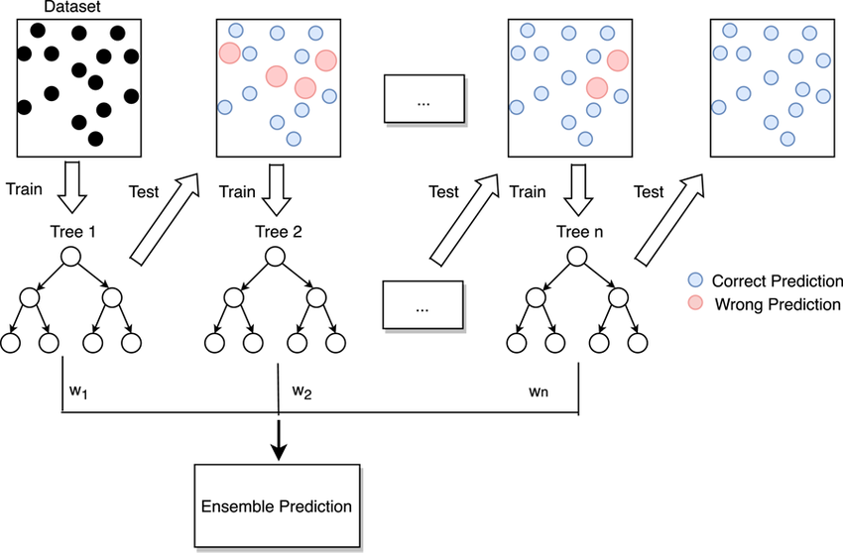
Gradient Boosting Ensemble Learning Method

Slide 7
Software and Hardware Requirements
Software Requirements
Operating System: Windows 7 or 10 Ultimate, Linux, Mac.
Coding Language: ReactJS, NodeJS for Front-end and ExpressJs, Python for Back-end
Software Environment: Visual Studio Code
Database: MongoDB
Hardware Requirements
Processor: Intel 1-3, 5, to 7
RAM: 4GB RAM or higher
Hard Disk: 500GB or higher

Slide 8
Algorithm
Gradient Boosting Algorithm for Fitness level prediction:
Step 1: Load fitness dataset and preprocess features including encoding categorical variables and normalization.
Step 2: Initialize ensemble model and set initial predictions as mean of target variable.
Step 3: Compute pseudo-residuals using negative gradient of loss function.
Step 4: Fit decision tree to predict pseudo-residuals and compute shrinkage parameter.
Step 5: Update ensemble predictions with scaled weak learner predictions.
Step 6: Save trained ensemble model to disk for future use.
Step 7: Iterate through boosting rounds to refine model and improve prediction accuracy.

Slide 9
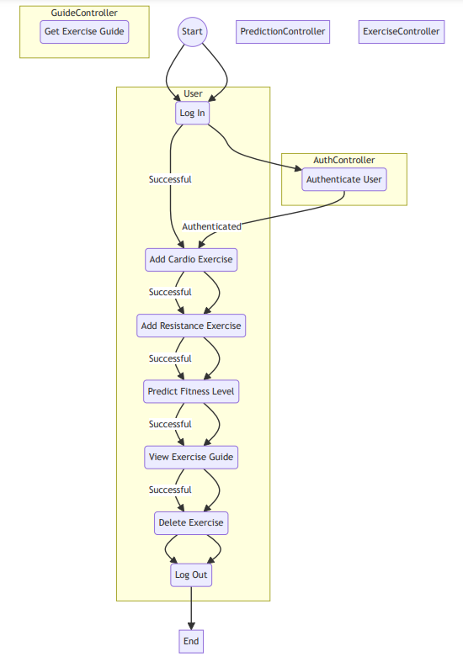
UML Diagrams
Activity diagrams in software engineering provide a graphical representation of control flow within a system, showcasing sequences of actions performed by different components or actors.
In the context of this project, activity diagrams illustrate step-by-step processes of fitness-related activities, aiding in understanding system behavior and optimizing user workflows for enhanced usability and efficiency.
Activity Diagram

Slide 10
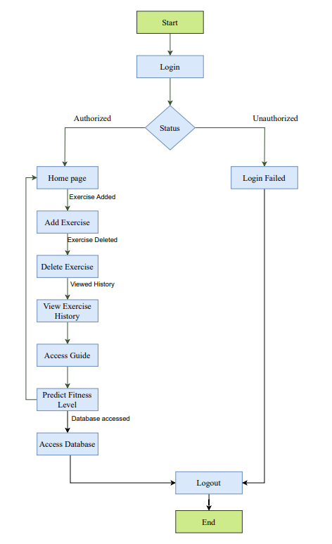
Flow diagrams visually represent process workflows, showcasing sequential steps and decision points to achieve specific outcomes using symbols and arrows.
In the context of database access within this project, the flow diagram illustrates interactions with the database, including tasks like adding, updating, or deleting records, facilitating a clear understanding of data management processes.
Flow diagram

Slide 11
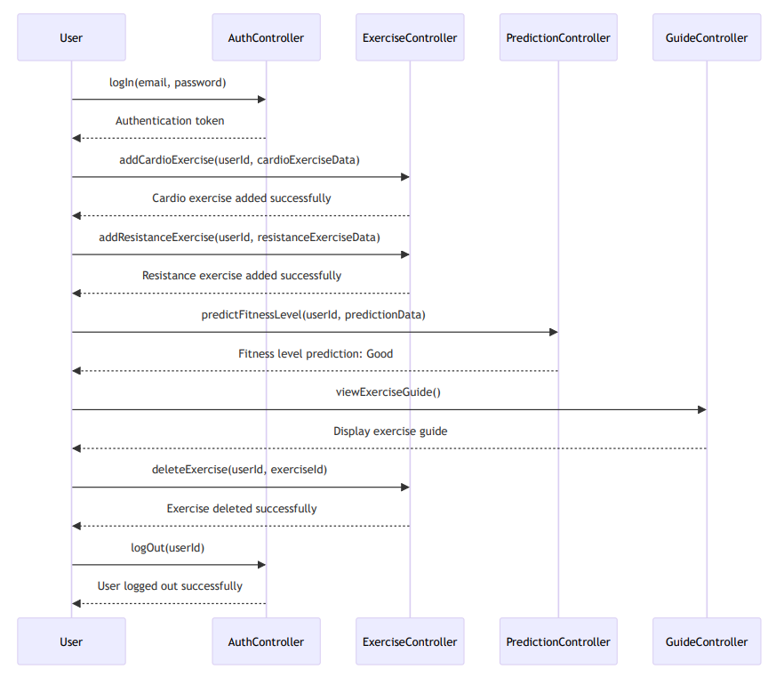
Sequence diagrams in software engineering illustrate interactions between objects or components in a step-by-step manner, showcasing the flow of messages and actions over time.
In the context of this project, sequence diagrams visualize user-system interactions, offering a detailed representation of events and aiding in identifying bottlenecks for refining system functionalities and optimizing performance.
Sequence Diagram

Slide 12
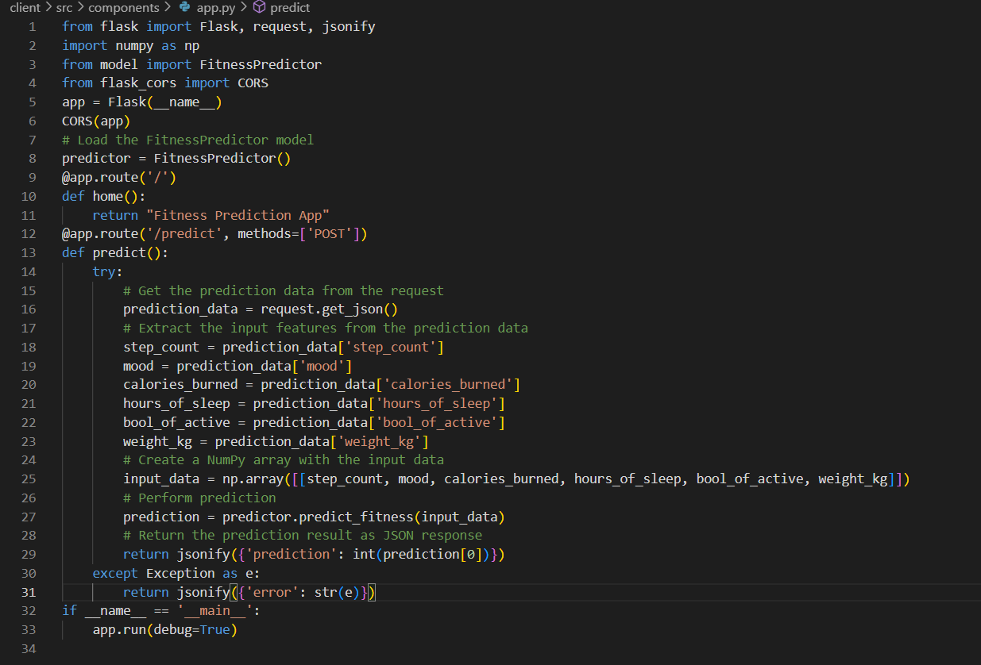
Sample Code
Flask API for Fitness Prediction Using Machine Learning Model

Slide 13
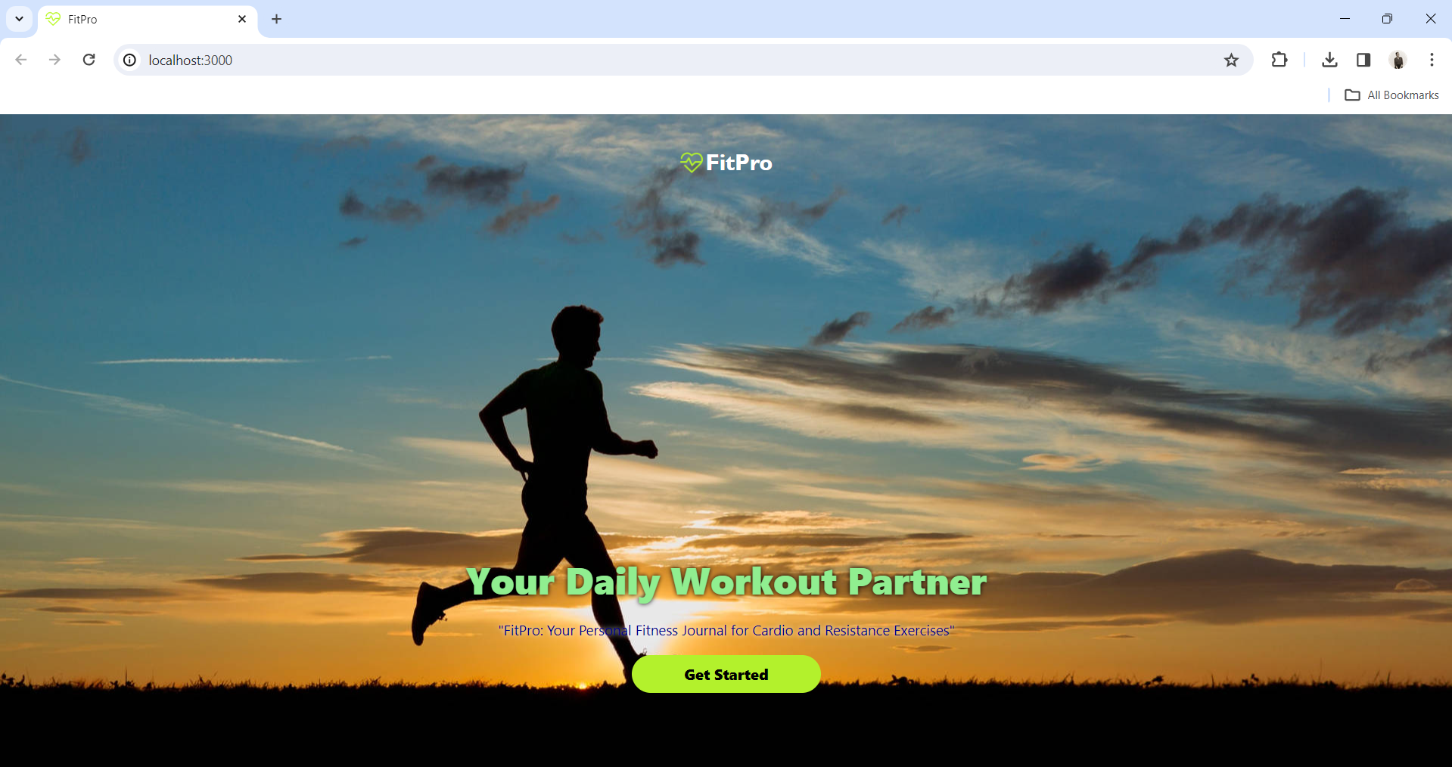
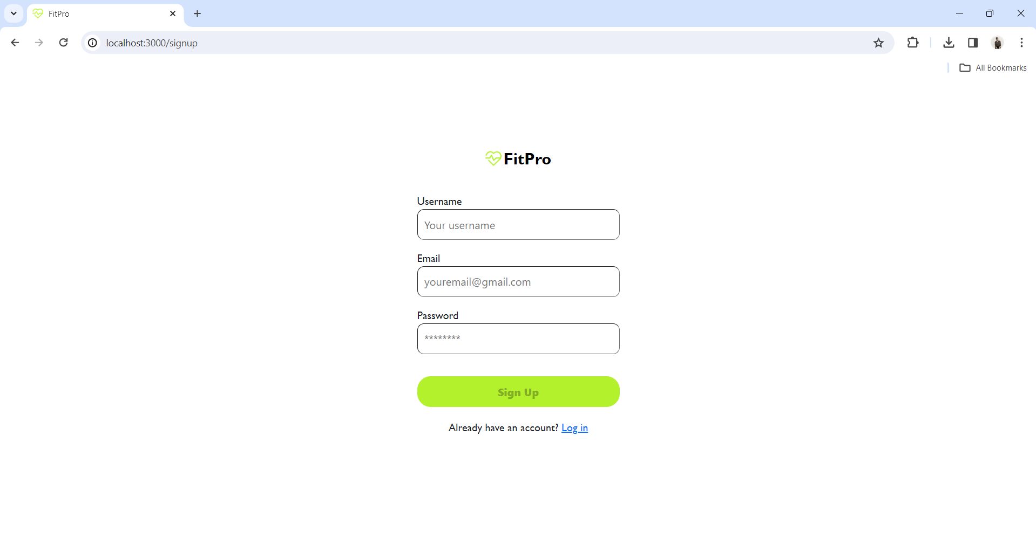
Output Screenshots
Home Page before Signup
Signup Page
The Home page which serves as the initial interface of the fitness tracking website, offering users an overview of its features and functionalities. The signup page enables new users to create an account, providing essential information such as username, email, and password to gain access to the platform's services.

Slide 14

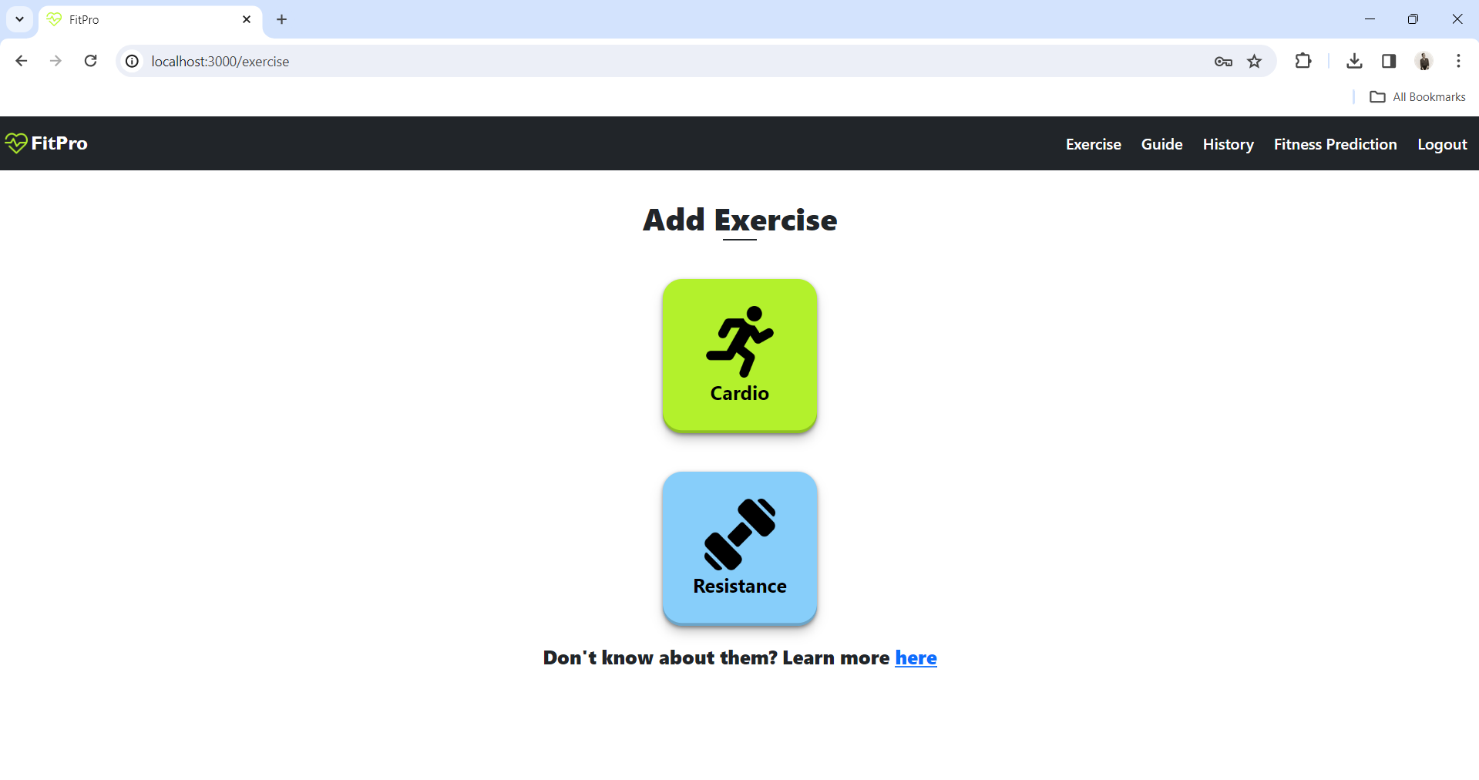
After Login page Add Exercise page
The Home page after login presents a personalized dashboard showcasing the user's fitness journey.
The Exercise page allows users to add the track of their exercise done either in cardio or resistance. If they don’t have any idea about exercise they can click on “here” link which redirects them to the Guide page to guide them about some exercises done frequently by beginners.

Slide 15
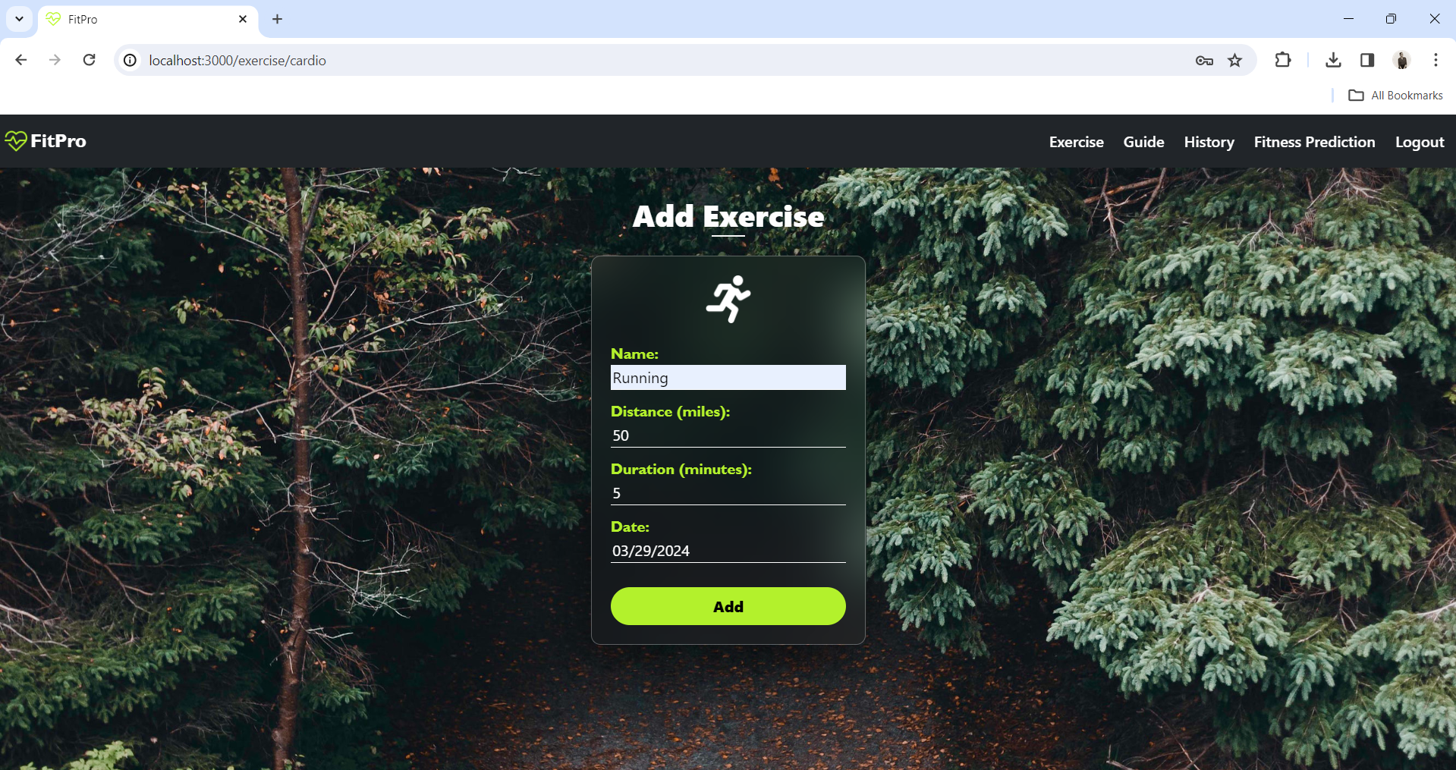
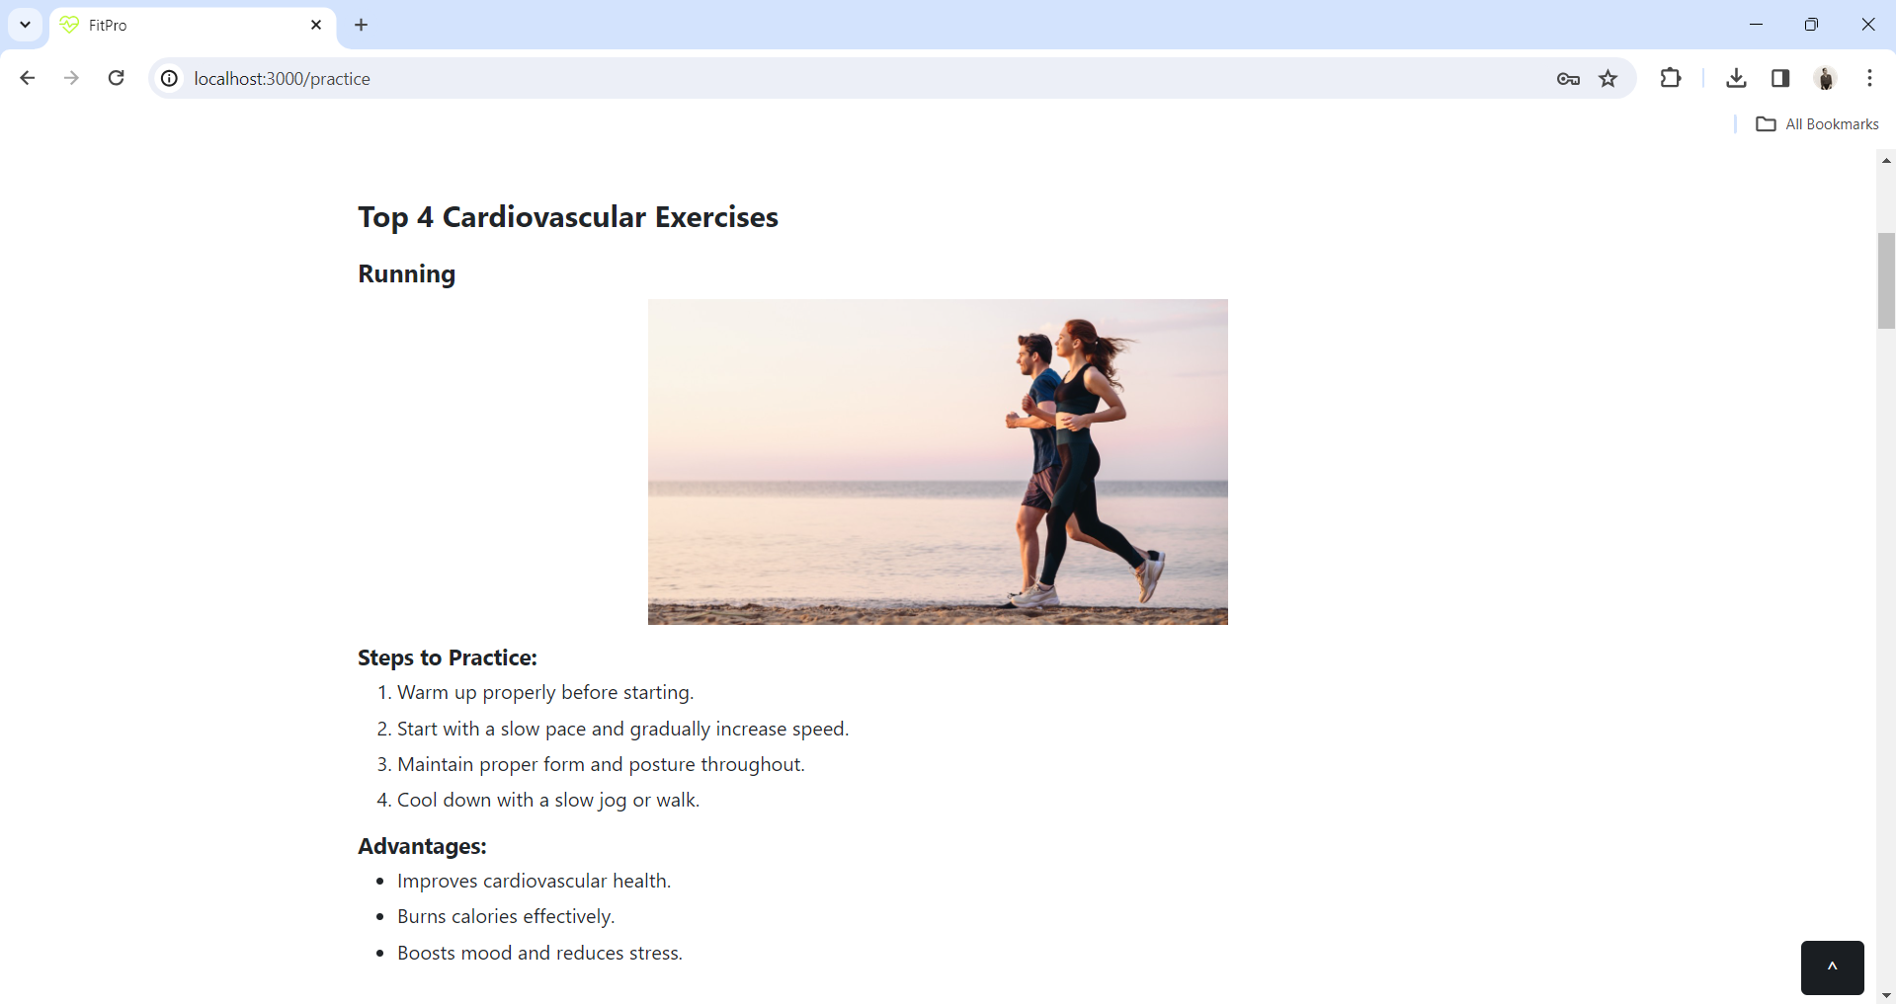
Add Exercise page Guide Page
The Add Exercise page which allows the users to add the cardio exercise record done by them and the Guide page which is used to guide the users how to practice cardio and resistance exercises by using images, steps to practice and describing the advantages of the exercises and this is the redirected page when from the Exercise page.

Slide 16
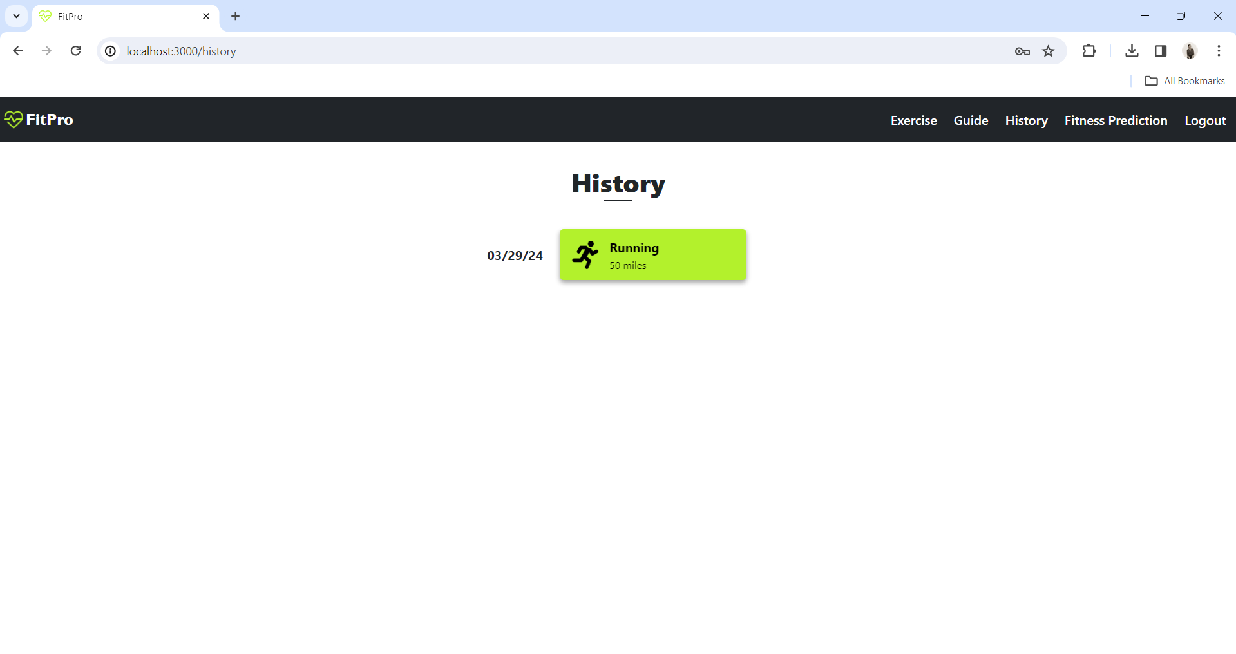
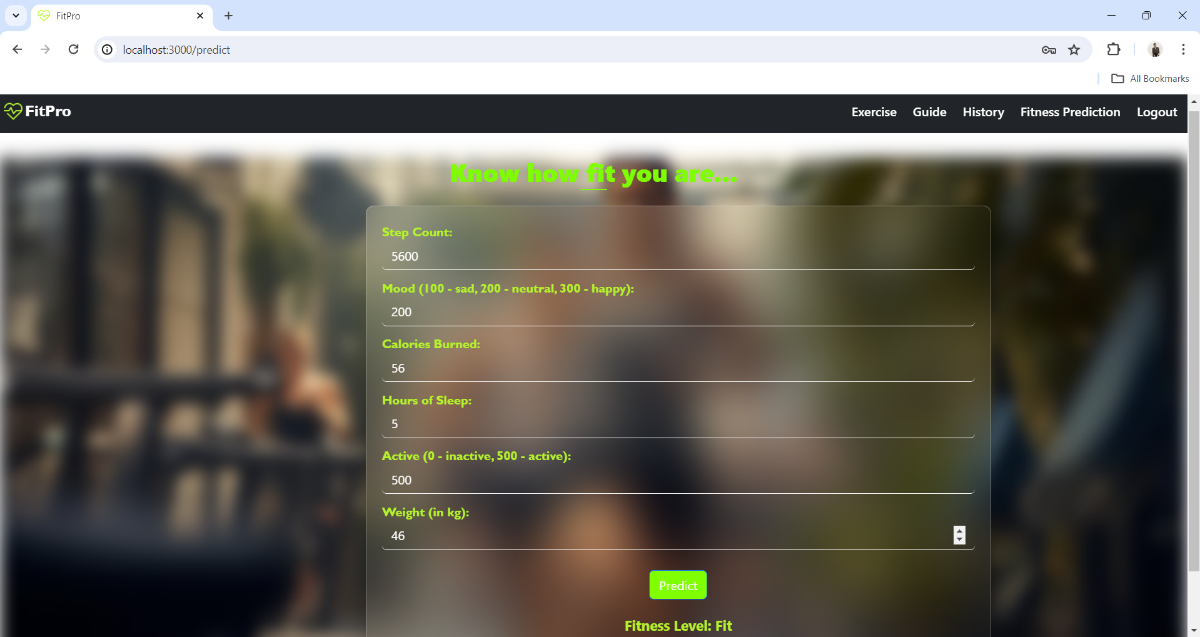
History Page Fitness Prediction Page
The History page which shows all the records of the user displays a comprehensive overview of the user's past exercises, allowing them to track their progress over time and make informed decisions for future workouts.
The Fitness Prediction page utilizes user inputs to generate personalized fitness assessments, offering insights into their current fitness level using machine learning techniques such as gradient boosting algorithm.

Slide 17
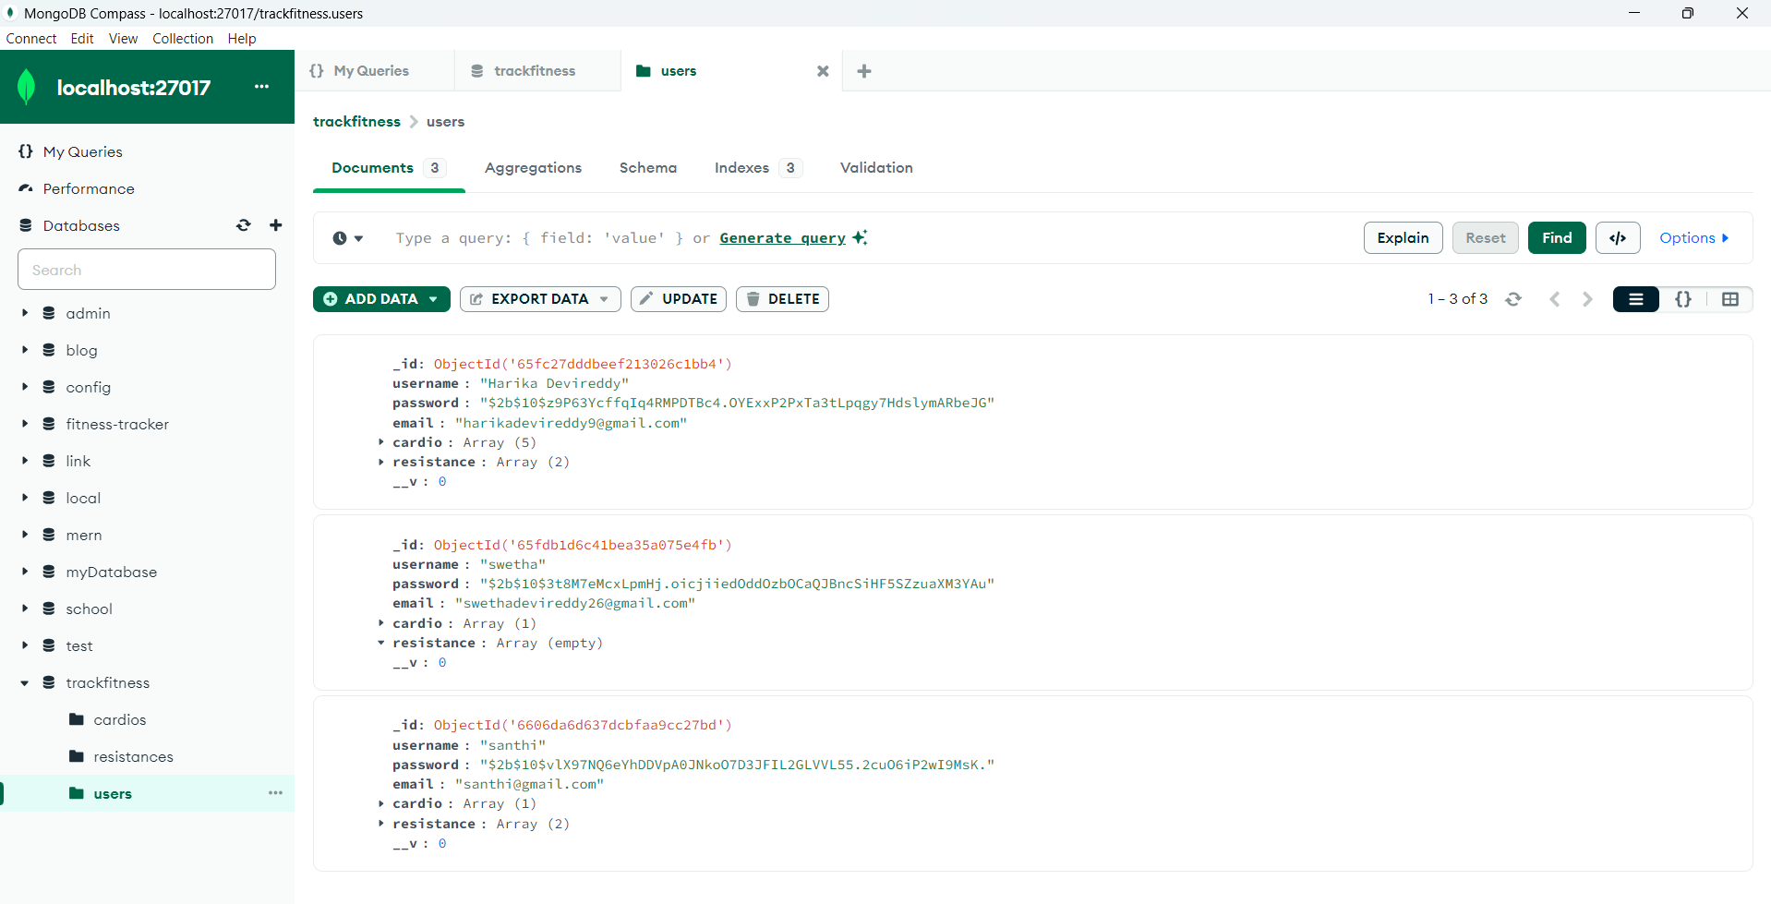
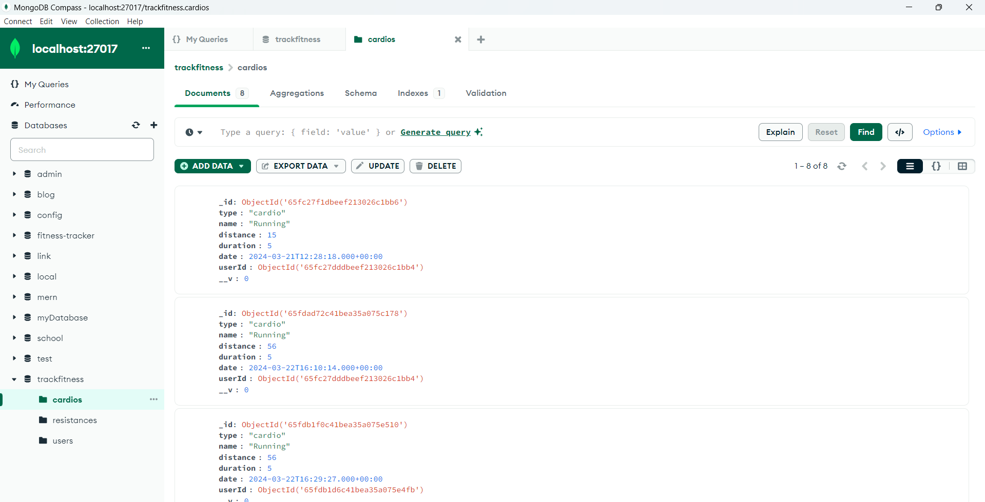
Screenshots of data stored in MongoDB
The MongoDB collections stores user information including email, password, and exercise data, encompassing details of both cardio and resistance exercises, facilitating comprehensive fitness tracking for each user.

Slide 18
References
Bender, Chelsea G., et al. "Measuring the fitness of fitness trackers." 2017 IEEE Sensors Applications Symposium (SAS). IEEE, 2017. Reichherzer, Thomas, et al. "Using machine learning techniques to track individuals & their fitness activities." CATA 2017. ISCA, 2017.
Nagovitsyn, Roman, Aleksander Osipov, and Mikhail Kudryavtsev. "The use of fitness trackers in the training process for increasing physical and functional abilities in athletes." 4th International Conference on Innovations in Sports, Tourism and Instructional Science (ICISTIS 2019). Atlantis Press, 2019.
Dubey, Durgesh Kumar. "AN ANALYTICAL STUDY OF USE AND EFFECTS OF FITNESS TRACKER ON HUMANS." International Conference on" Modern Trends in Business. 2018.
Reichherzer, Thomas, et al. "Using machine learning techniques to track individuals & their fitness activities." CATA 2017. ISCA, 2017.
Merenda, Massimo, et al. "A novel fitness tracker using edge machine learning." 2020 IEEE 20th Mediterranean Electrotechnical Conference (MELECON). IEEE, 2020.

Slide 19
Thankyou

